Slide 1
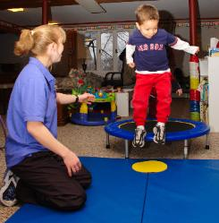
Seymour Recreation Welcomes
TUMBLETRAIN MOBILE GYMNASTICS
“Keeping Kids On Track To A Healthy Lifestyle”
Tumbletrain Mobile Gymnastics is a fun and energetic class with something new and different every week. Each 30 minute class will consist of warm-up time to music, encouraging movement, teaching motor skills and demonstrating the importance of stretching. Classes will conclude by developing fine motor skills using a wide range of props including bean bags, balloons, balls, hoops, etc.
For full class descriptions based on age please visit our website www.seymourcommunityservices.com
Date: September 27- November 1 Days: Thursday
Time: Varies by Age Location: Seymour Community Center Price: $60
Instructor: Fran DelVecchio
*All Classes Will Be Held at the Seymour Community Center*
To Register Go To: www.seymourcommunityservices.com
203-888-0406 www.facebook.com/seymour.ct
20 Pine Street Seymour 06483

