Slide 1
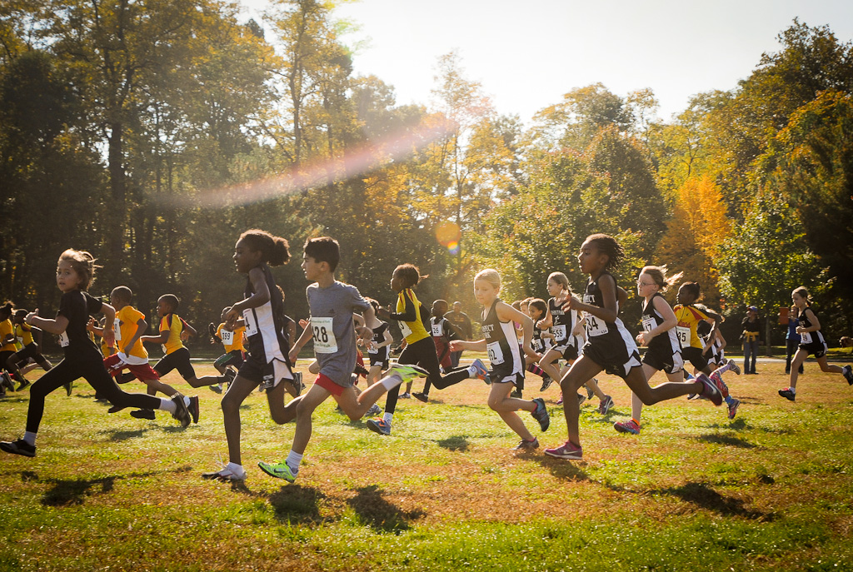
Before School Running/Walking Club
Seymour Recreation
Youth Running Programs
This running/walking club is a great opportunity for children to become physically fit before school. Children will learn a variety of running concepts - including proper stretching and running techniques, pacing, training methods, proper hydration, and nutrition. Regular exercise not only keeps children physically fit and healthy but is also known to improve students focus and behavior while raising academic and fitness scores.
Where: Chatfield Park
Dates: Sept 25- Nov 16 When: Tuesdays & Friday
Time: 7:45-8:30am Cost: $85 Grades: 2-5
*Bus transportation to Bungay/Chatfield schools at the end of each morning*
To Register Go To: www.seymourcommunityservices.com

