Slide 1
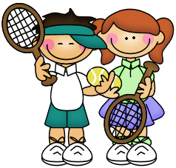
Seymour Recreation Marcy’s Tennis ACADEMY
Marcy's Tennis Academy gives your child the correct foundation to enjoy tennis for life.
The program emphasizes fun, not competitive stress, with every child developing racquet skills, focus, agility and, most importantly, sportsmanship. No matter the skill level of your child, he or she will learn the correct way to hit shots, move on the court and observe the rules of the game.
Dates: September 25- October 30
Day: Tuesday
Times: 3:40-4:40pm
Price: $85
Grades: K-5
Location: Chatfield Lo-Presti School
To Register Go To: www.seymourcommunityservices.com or call 203-888-0406.
*Online registration is recommended*
*Children must bring their own racquet. Racquets can be purchased through MTA*
To Register Go To: www.seymourcommunityservices.com

