Slide 1
KetoworX
30-day Community Weight loss Challenge
“Eat Fat to get FIT”

Slide 2
About ME…
RN at Yale ED SRC campus, Subsitute RN for Seymour School District.
Two young children; Tyler 8yrs old attends CLS and Makayla 2.5yrs attends Explorer’s.
Started Keto 3/7/18 and am down 27lbs!

Slide 3
ABOUT ALL OF YOU…
Meet and greet time!!!

Slide 4
Why am I doing this…
As a nurse, I have a passion to HELP people! The Ketogenic lifestyle has many benefits and I want to share a better way of eating with my community to hopefully spread awareness that this is a healthy lifestyle for EVERYONE!!! Whether or not you have a chronic disease or want to achieve sustainable weight loss.
“Nature is the healer of Disease” Hippocrates.

Slide 5
No Keto is NOT Atkins!!!
Atkin’s focused strictly on NO Carbohydrates, which cut out vegetables and fruit. Keto on the other hand uses “net carbs”… which allows you to minus carbohydrates from fiber! You can have fiber! Carbohydrates from fiber do not raise your blood sugar and cause an insulin response.

Slide 6
What will happen when I enter Ketosis
Right now, your bodies energy source is glucose from carbohydrates.
When you cut out carbohydrates from grains, sugar, certain fuits and starchy vegetables… your body starts to release ketones to burn fat for energy.
I don’t know about you, but I have plenty of FAT to start to fuel my body!!!!
What can happen in the first few days…
Frequent urination.
Dizziness/drowsiness.
Flu-like symptoms- minus a fever.
Constipation/diarrhea.
Smelly breath
Sleep issues
AVOID ABOVE BY:
DRINKING PLENTY OF WATER
ELECTROLYTE SUPPLEMENTS, IE; VITAMIN OR DRINK
EAT ENOUGH HEALTHY FATS

Slide 8
So what vegetables are approved for Keto???
ANY ABOVE GROUND GREEN VEGETABLE!!!

Slide 9
Yes, you can have fruit too!
For the next thirty days for best results keep your fruit intake to “berries” only!!!

Slide 10
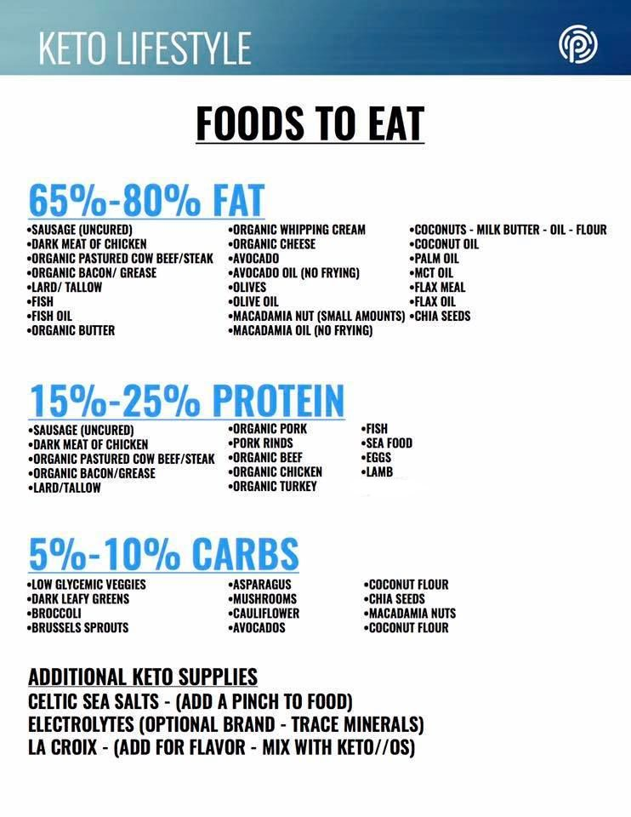

Slide 11
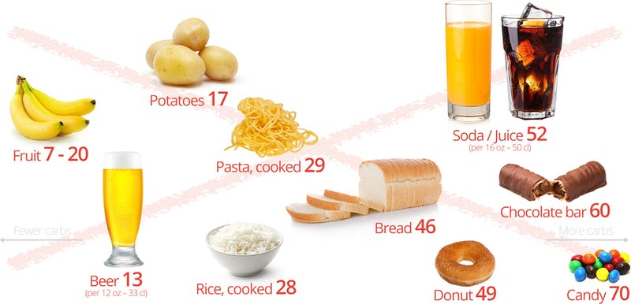
AVOID…

Slide 12
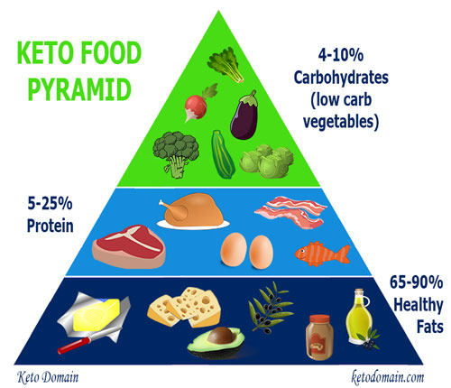

Slide 13
We will meet once a week here at the community center!
Sign up time…

Slide 14
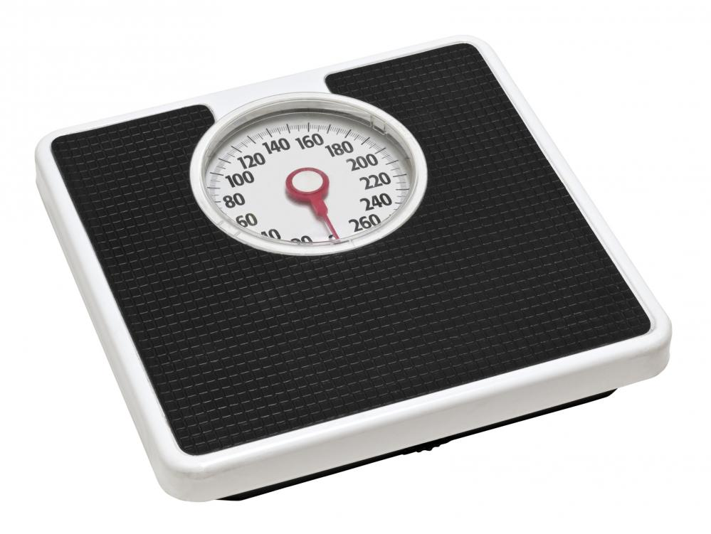
Weigh-in time!!!

Slide 15
STAY HYDRATED
WATER, WATER, WATER…
These can also help with “keto flu” Keto flu can be prevented with proper hydration and vitamins/minerals!!!
“The cause. The keto flu is caused by the transition when your body starts burning fat for energy instead of sugar. Most of the symptoms are caused by a lack of water and salt, caused by a temporarily increased urine production as the body enters ketosis (the increased fat-burning mode).”

Slide 16
Electrolytes become depleted on a ketogenic diet due to increased water excretion and decreased water retention. Important electrolytes to focus on during a ketogenic diet are: sodium, potassium, and magnesium. Increasing your water intake is important on a ketogenic diet to maintain hydration

Slide 18
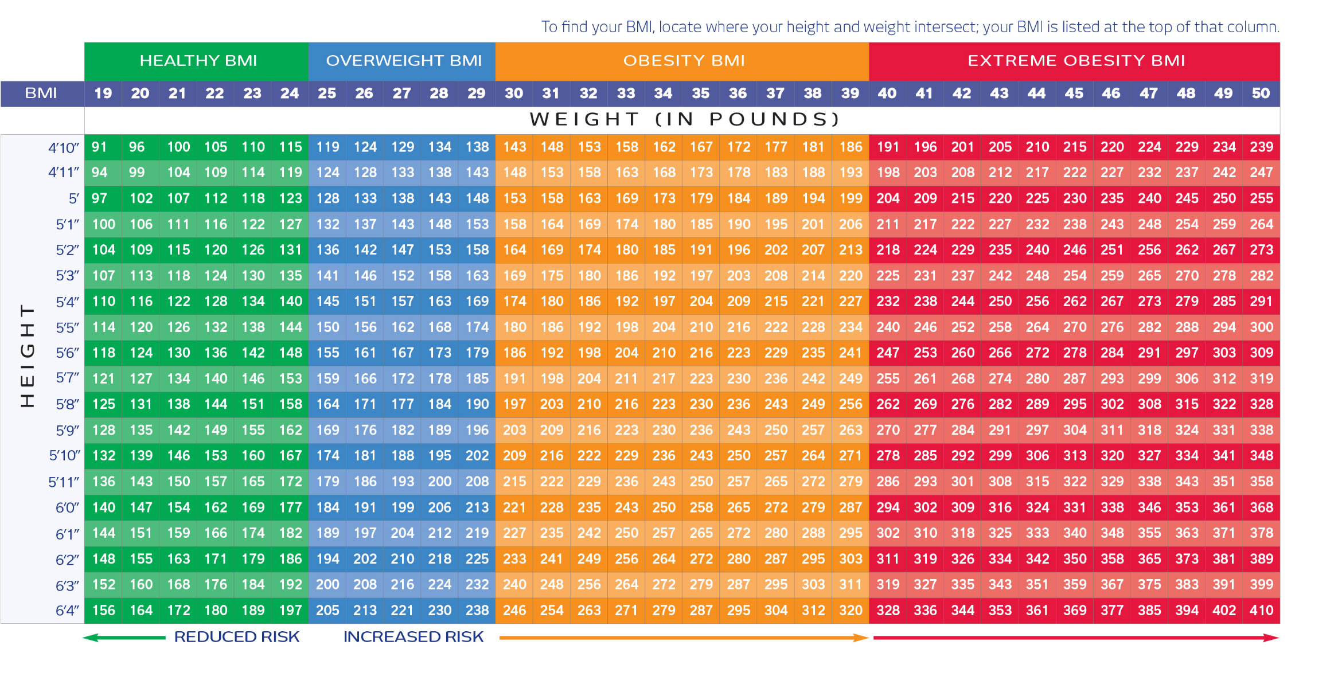

Slide 19
HOMEWORK…
Watch “The Magic Pill” Netflix documentary… take notes!!!
Download and create profile on MyFitnessPal and send me friend request at: kposs0
Download and create PINTEREST account- TRUST ME, lifesaver!!!!
Clear one kitchen cabinet in your kitchen… this is the ONLY cabinet you will turn to!!!
Take pictures of all your meals for the next week!!!

Slide 20
How do I invite a current member to be my friend on MyFitnessPal? On the Web - Username or Email address Log into your account on our website at http://www.myfitnesspal.com. Mobile app users should log in using the same username and password they use in the app. Click the "Community" tab, then click "Find Member." Fill in the "Username or Email" field and click "Search." You will be taken to the member's profile page, where you can click "Add as Friend" to send a friend request. Adjust your MACROS by going to “me” tab and then “update goals” and click on “calorie and macronutrient goals” Adjust carbs to 5%, Protein to 20% and fat to 75% KEEP YOUR CALORIE INTAKE AT DEFAULT FROM APPLICATION BASED ON TWO LB PER WEEK GOAL!!! FOR THE NEXT 30 DAYS YOU MUST LOG ALL YOUR FOOD, IF YOU WANT TO STAY ON TRACK… YOU DON’T HAVE TO DO THIS FOREVER… I PROMISE!

