Slide 1
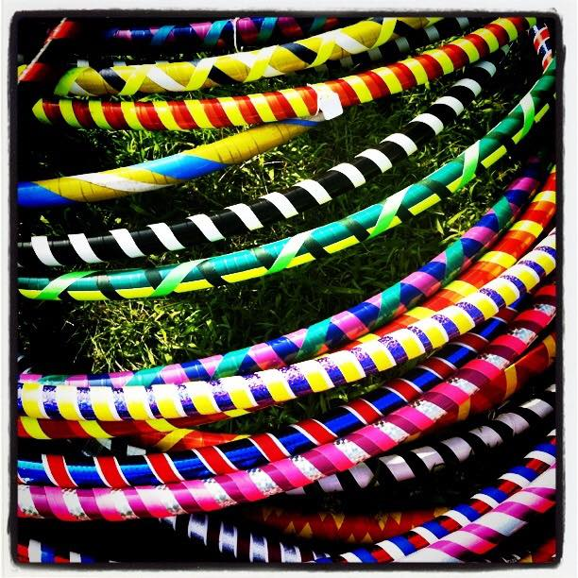
Seymour Recreation Welcomes Adult Hoop Fitness and Flow by BringtheHoopla
A perfect place for any level to work on toning and strengthening core while expressing their inner self through dance. We focus on increasing flexibility, focus and stamina while toning glutes, thighs, arms while creating your own hoop journey. This energized class is designed for letting loose, finding your flow and burning up to 500 calories in an hour.
Dates: October 30 - December 4
Location: Seymour Community Center
Day: Tuesday
Times: 6:00-7:00pm
Price: $65
To Register Go To: www.seymourcommunityservices.com or
call 203-888-0406.
*Online registration is recommended*
To Register Go To: www.seymourcommunityservices.com

