Slide 1
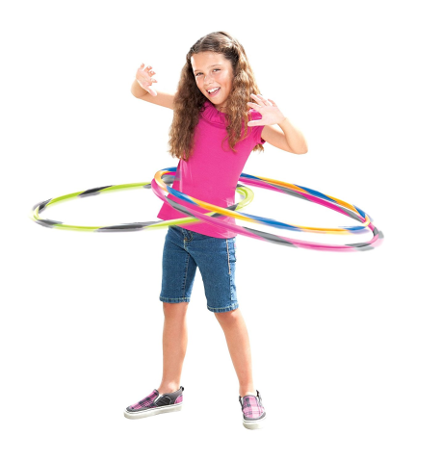
Seymour Recreation Welcomes Happy Hoopin’ by BringTheHoopla
In this high-energy hoop class, we combine physical fitness with a variety of hoop games that build stamina and focus, foster team-building, leadership and cooperative play. We teach on and off body hoop tricks while enjoying age-appropriate music and creating a welcoming environment where creativity and self-expression are encouraged. We build self-confidence through hooping and there is never a dull moment in this class!
Dates: September 27- November 1
Location: Chatfield - LoPresti School
Day: Thursday
Grade: 1st - 5th grade
Times: 3:40-4:40pm
Price: $65
Early Dismissal Start Time will be 1:40pm: 9/27, 10/18
*Transportation can be provided for Bungay School students*
To Register Go To: www.seymourcommunityservices.com or
call 203-888-0406.
*Online registration is recommended*
To Register Go To: www.seymourcommunityservices.com

