Slide 1
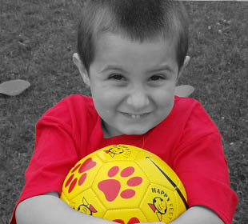
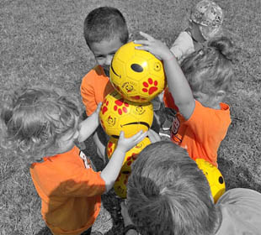
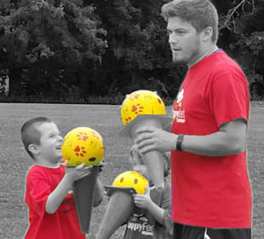
HappyFeet Soccer Program
Seymour Recreation
Youth Soccer Programs
The HappyFeet Youth Soccer League is an excellent opportunity to see your little one further develop and showcase his/her HappyFeet soccer skills. The league curriculum maximizes fun and friendship to ensure your child always wants to come back!
Date: September 23- November 11 Days: Sunday Mornings
Ages: 3-5
Time: 10:30-11:30 am Location: Seymour Middle School Soccer Field Price: $95
perfect way to introduce kids ages 3 to 5
to organized team sports!
To Register Go To: www.seymourcommunityservices.com

