Slide 1
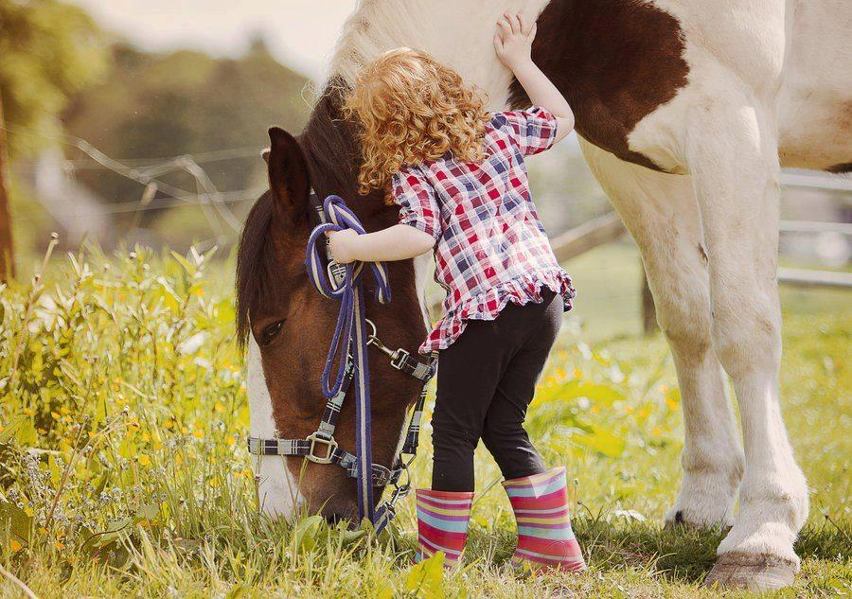
Seymour Recreation Columbus Day Vacation Camps
GrandPrix, NY: Middle Schoolers will enjoy fun day of go kart racing, bowling, and the arcade. Bring extra money for food, games, etc…
Date: October 8, 2018 Time: 9-2:00 pm Grades: 6-8
Location: Grand Prix, Mt. Kisco, NY Price: $40
Horseback Riding Camp: Camp includes riding lessons, grooming, feeding the horses, and horsemanship skills & equine anatomy.
Date: October 8, 2018 Time: 9-1:00 pm Ages: 5 and up Location: Little Bit Farm, Seymour Price: $48
To Register Go To: www.seymourcommunityservices.com

